Slide 1
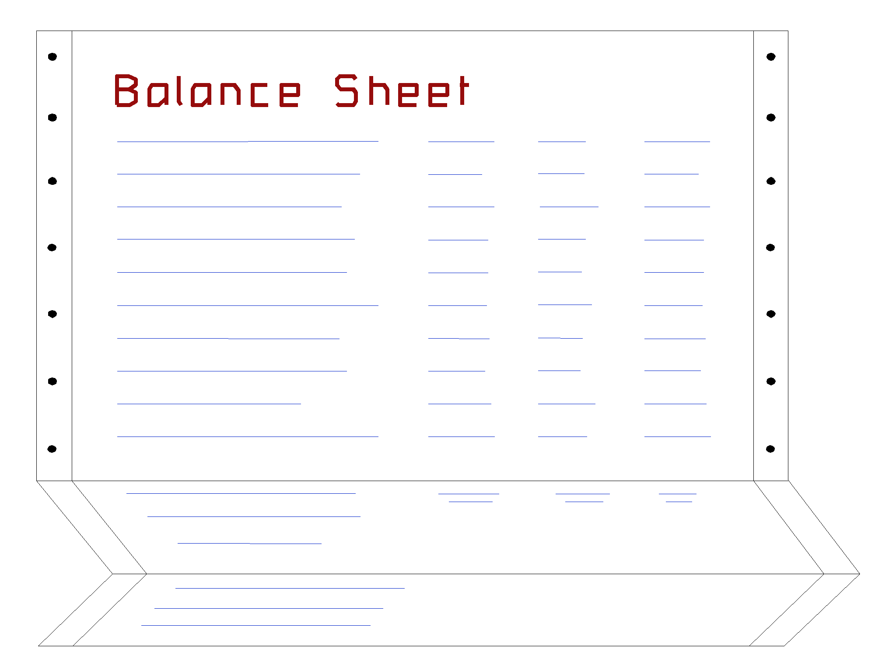
The Statement of Cash Flows
Statement of Cash Flows
Summarizes cash transactions for an accounting period.
Includes cash and cash equivalents.

Slide 2
Cash Management
λAccurately account for cash.
λPrevent theft and fraud.
λAssure the availability of adequate amounts of cash.
λAvoid unnecessarily large amounts of idle cash.

Slide 3
Using Excess Cash Balances Efficiently
Cash available for long-term investment may be used to finance growth and expansion of the business, or to
repay debt.
Cash not needed for business purposes should be distributed to the company’s stockholders.

Slide 4
Internal Control Over Cash
λSegregate authorization, custody and recording of cash.
λPrepare a cash budget.
λPrepare a control listing of cash receipts.
λRequire daily deposits.
λMake all payments by check.
λVerify every expenditure before payment.
λPromptly reconcile bank statements.

Slide 5
Cash Over and Short
On May 5, XBAR, Inc.’s cash drawer was counted and found to be $10 over.
Cash Over and Short is debited for shortages and credited for overages.

Slide 6
Bank Statements
Shows the beginning bank balance, deposits made, checks paid, other debits and credits in the month, and the ending bank balance.
Bank Statement

Slide 7
Reconciling the Bank Statement
Explains the difference between cash reported on bank statement and cash balance in depositor’s accounting records.
 | Provides information for reconciling journal entries.

Slide 8
Reconciling the Bank Statement
Balance per Bank
Balance per Depositor
+ Deposits in Transit
- Outstanding Checks
± Bank Errors
= Adjusted Balance
+ Deposits by Bank (credit memos)
Service Charge NSF Checks
± Book Errors
= Adjusted Balance

Slide 9
Reconciling the Bank Statement
All reconciling items on the book side require an adjusting entry to the cash account.
Balance per Depositor
+ Deposits by Bank (credit memos)
Service Charge NSF Checks
± Book Errors
= Adjusted Balance

Slide 10
Reconciling the Bank Statement
Example
Prepare a July 31 bank reconciliation statement and the resulting journal entries for the Simmons Company. The July 31 bank statement indicated a cash balance of
$9,610, while the cash ledger account on that date shows a balance of $7,430.
Additional information necessary for the reconciliation is shown on the next page.

Slide 11
Outstanding checks totaled $2,417.
A $500 check mailed to the bank for deposit had not reached the bank at the statement date.
The bank returned a customer’s NSF check for
$225 received as payment of an account receivable.
The bank statement showed $30 interest earned on the bank balance for the month of July.
Check 781 for supplies cleared the bank for $268 but was erroneously recorded in our books as
$240.
A $486 deposit by Acme Company was erroneously credited to our account by the bank.

Slide 12
Reconciling the Bank Statement
Example
Reconciling the Bank Statement
Example
Balance per bank statement, July 31 | $ 9,610
Additions:
Deposit in transit | 500
Deductions:
Bank error $ 486
Outstanding checks 2,417 | 2,903
Adjusted cash balance | $ 7,207
Balance per depositor's records, July 31 | $ 7,430
Additions:
Interest | 30
Deductions:
Recording error $ 28
NSF check 225 | 253
Adjusted cash balance | $ 7,207
McGraw-Hill/Ir
_{win} © The McGraw-Hill Comp
anies, Inc., 2002

Slide 13
Reconciling the Bank Statement
Example
GENERAL JOURNAL
Date |  | Account Titles and Explanation | Debit | Credit
Jul | 31 | Cash | 30
 |  | Interest Revenue |  | 30
 | 31 | Supplies Inventory | 28
 |  | Accounts Receivable | 225
 |  | Cash |  | 253

